Slide 1

IS 312 Web Design and Programing
JS, DOM, and Events
Module 03 – Introduction Coding Env, HTML and CSS
School of Technology & Computing (STC)
City University of Seattle (CityU)

Slide 2
Welcome to Programmable Web Architectures
Moving Beyond Static Structural Markup
Introduction to Client-Side Logic Execution
JS Role as the Engine of the View
Notes:
Welcome, everyone. Up to this point, we have used HTML and CSS to create static layouts. Today, we introduce JavaScript—the execution layer that transforms static document objects into dynamic, programmable applications, setting the stage for modern frameworks like React.

Slide 3
Getting Started with Client-Side Scripts
Script Placement Pipelines ( <script>)
The Architecture of Non-Blocking Loading (defer vs async)
The Console Env as an Engineering Workspace
Notes:
To run JavaScript in a browser, we embed or link it using the <script> tag. Because browsers read files from top to bottom, a script can block HTML parsing. We use the defer attribute to tell the browser to download the script in parallel but wait until the HTML document is fully parsed before executing it.

Slide 4
Essential Language Primitives
Scoping Variables Cleanly ( let, var, const)
Primitive Types: String, Numbers, Booleans
Complex Collections: Object literals and Data Arrays
Notes:
Modern JavaScript relies on clean scoping rules. Use const by default for variables that will not be reassigned, and let for values that change over time. Avoid legacy var declarations, which introduce unpredictable variable hosting bugs into your call stack.

Slide 5
Control Flow: Conditional and Functional Execution
Decision Branches via if … else Patterns
Encapsulation Code via Functions
Parameter Inputs and Explicit return Values
Notes:
Control flow allows our application to make decisions. We use if blocks to run code conditionally based on boolean evaluations. To keep our code organized and maintainable, we bundle reusable instructions into functions that accept input parameters and pass processed outputs back using return statements.

Slide 6
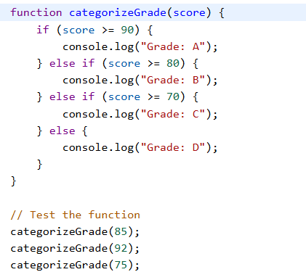
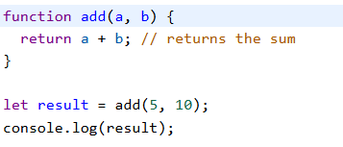
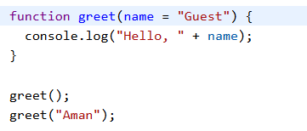
Code Expample

Slide 7
Advanced Iteration and Arrow Functions
Concise Expression Handling with Arrow Syntax (=>)
Iterating Arrays cleanly via .forEach() and .map()
Preparing Pipelines for Component Architectures

Slide 8


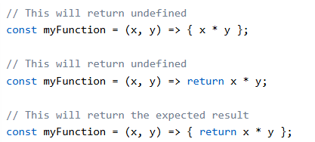
Code Examples Arrow Functions

Slide 9
The Document Object Model DOM
Core Document Node Root
Mapping Parent, Child, Sibling Node Relationships
The Difference Between an Element Node and a Text Node.
Notes:
The DOM is a live tree structure where every single thing on the page—including the text spaces and HTML comments—is a node object. As developers, we parse this tree by navigating relationships: moving from a parent container down to its child elements, or skimming sideways across adjacent sibling nodes.

Slide 10
Querying and Query Selections (DOM)
Targeted Selection via
  document.querySelector()
Fetching Node Collections via
  document.querySelectorAll()
Iteration Over Static NodeList safely
Notes:
To change a page element, we first have to find it. The querySelector method takes any standard CSS selector string and returns the very first element match it encounters. If you need to manipulate a whole group of matching elements, querySelectorAll gathers them all into a standard NodeList collection that you can iterate through using an array loop."

Slide 11
Live Manipulation of Elements
Modifying Node Content ( textContent vs. innerHTML)
Updating Visual Presentations via the Element .style Object
Safe Management of Structural State via .classList
Notes:
Once we have captured an element node, we can modify it directly. Setting textContent swaps out raw text safely. If we want to change CSS values on the fly, we can use the .style object or cleanly add and remove class strings using the .classList primitive API—which is the industry standard approach for controlling layouts dynamically.

Slide 12
Registering Interactions: Event Listeners
Binding Triggers via
  element.addEventListener()
Specifying Interaction Signals
  click, submit, keyup
Decoupling the Event Type from the Callback Logic
Notes:
To make a page react to user input, we attach event listeners. The addEventListener method takes two primary parameters: the explicit signal string we are listening for—such as 'click' or 'submit'—and the callback function that should run the moment that exact user interaction takes place.

Slide 13
Event Propagation: Bubbling and Capturing Phases
The Event Flow: Capturing Downward, Bubbling Upward
Intercepting Event Intersection via
  event.target
Halting Execution Cascades with
  event.stopPropagation()

Slide 14


Q&A

